Slide 1
CS97: Introduction to Data Science
06: Classification Evaluation and Model Selection
Instructor: Shichang Zhang
shichang@ucla.edu

Slide 2
Announcement
Homework 1 is due today at 10 pm
The project proposal is also due 10 pm today (no grades, only feedback)
This afternoon: our first research seminar!
Time: 1 pm - 2:30 pm,
Location: Boelter Hall 3400
Speaker: Prof. Aditya Grover
Students from CS 30 (CSSI Introductory Level) will join us
Snacks will be provided
Back to normal discussion/lab in your discussion classroom

Slide 3
Seminar: Human-AI Interaction
Title: Foundation Models for a Sustainable Planet
Abstract: Key global sustainability challenges, ranging from ensuring food and energy security to managing disaster response, critically depend on our ability to accurately forecast weather and project climate. While current approaches are limited by our physical understanding of the atmosphere, improvements in sensory capabilities and large-scale machine learning (ML) present immense opportunities for designing alternative solutions. In this talk, I will discuss key design principles for developing foundation models for atmospheric sciences. Unlike language and vision, scientific domains present unique challenges due to the significant heterogeneity of available datasets. Moreover, downstream tasks in atmospheric sciences require generalizing across a broad range of variables and spatiotemporal resolutions. To address these challenges, I will demonstrate novel strategies for data engineering, model design, spatiotemporal optimization, and cross-modal finetuning aimed at scalable learning of atmospheric foundation models. Our resulting models exhibit exceptional skill, speed, and adaptability across a range of predictive tasks in weather and climate science. Finally, I will summarize the broader implications of this research for scientific ML and growing external efforts to adapt our models for diverse sustainable development goals.
Bio: Aditya Grover is an assistant professor of computer science at UCLA. His research interests are at the intersection of generative modeling and sequential decision making, and grounded in applications for accelerating science and sustainability. Aditya’s research has been recognized with a best paper award (NeurIPS), several graduate fellowships and faculty awards (Google, Meta, Microsoft, Schmidt Sciences, Simons Institute), the Forbes 30 Under 30 List, the AI Researcher of the Year Award by Samsung, the Kavli Fellowship by the US National Academy of Sciences, and the ACM SIGKDD Doctoral Dissertation Award. Aditya received his postdoctoral training at UC Berkeley, PhD from Stanford, and bachelors from IIT Delhi, all in computer science.

Slide 4

Week 1 Survey
Please take this survey to help us improve our teaching so we can better help you.
https://forms.gle/k7Kv8cc2q2BenXsF8

Slide 5
So far …
We have learned a new task called classification
And a new algorithm called logistic regression for classification

Slide 6
Next
How do we address overfitting issue for logistic regression?
How do we evaluate classification models
How do we select classification models

Slide 7
Content
Regularization in Logistic Regression
Model Evaluation in Classification
Practical Issues

Slide 8
Regularization in Logistic Regression

Slide 9
Review: Regularization in Linear Regression
In linear regression the goal is to minimize the sum of squared error (equivalent to MSE):

Slide 10
Review: Regularization in Linear Regression
And a regularization approach was to add a penalty factor to this equation. E.g., Ridge Regression becomes:
Note: this penalty shrinks the estimates towards zero
Notes:
https://stats.stackexchange.com/questions/368002/lasso-and-ridge-from-the-bayesian-perspective-what-about-the-tuning-parameter

Slide 11
Regularization in Logistic Regression
A penalty factor can then be added to this loss function and results in a new loss function that penalizes large values of the parameters:
The result is just like in linear regression: shrink the parameter estimates towards zero.
In practice, the intercept is usually not part of the penalty factor.
Note: the sklearn package uses a different tuning parameter: instead of $λ$ they use a constant that is essentially $C=\frac{1}{λ}$.
Log-likelihood
$$\underset{β_{0},β_{1},…,β_{p}}{argmin}⁡\left[−\sum_{i=1}^{n}{\left(y_{i}\ln\left(p_{i}\right)+\left(1−y_{i}\right)\ln\left(1−p_{i}\right)\right)}+λ\sum_{j=1}^{p}{β_{j}^{2}}\right]$$

Slide 12
Review: Why log-likelihood?
The base of log does not matter. Assume we use natural base.
$\ln\left(L_{1}×L_{2}×⋯×L_{100}\right)=lnL_{1}+lnL_{2}+⋯+ln⁡L_{100}$
$likelihood= {0.8}^{100}≈0$
$loglikelihood= ln\left({0.8}^{100}\right)=100ln0.8=−22.31$

Slide 13
Regularization in Logistic Regression: an Example
Let’s see how this plays out in an example in logistic regression.

Slide 14
Regularization in Logistic Regression: an Example
Let’s see how this plays out in an example in logistic regression. (recall: $C=1/λ$)
Blue: L2
Black: L1

Slide 15
Regularization in Logistic Regression: tuning $λ$
Just like in linear regression, the regularization weight must be chosen. How should we go about doing this?
Through building multiple training and test sets (through k-fold or random subsets), we can select the best weight to mimic out-of-sample prediction.
How could we measure how well each model fits the test sets?
We should measure this based on some loss function!
Notes:
accuracy

Slide 16
Regularized Decision Boundaries
Notes:
Log(p/1-p)

Slide 17
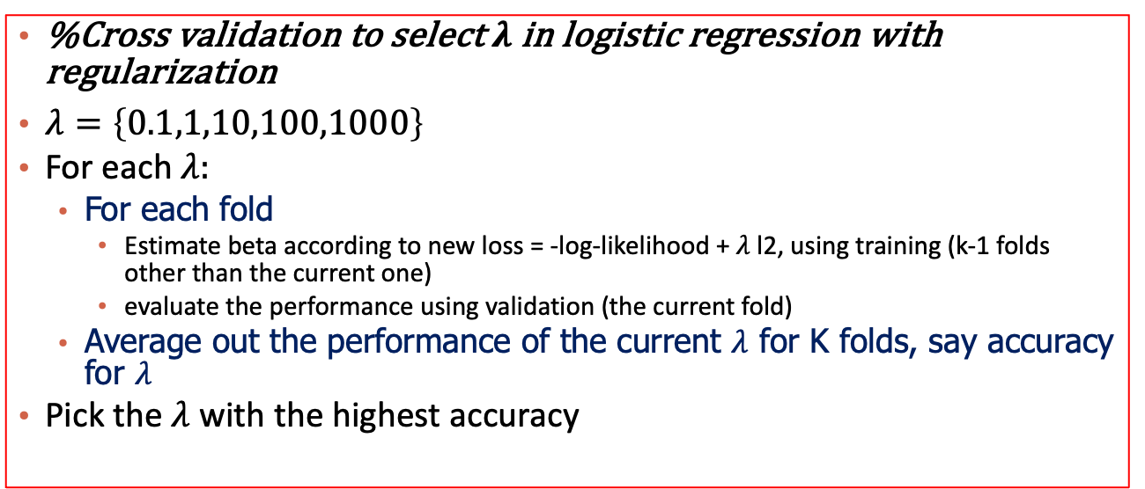
Cross validation to select $λ$
%Cross validation to select $λ$ in logistic regression with regularization
$λ=\left\{0.1,1,10,100,1000\right\}$
For each $λ:$
For each fold
Estimate beta according to new loss = -log-likelihood + $λ$ l2, using training (k-1 folds other than the current one)
evaluate the performance using validation (the current fold)
Average out the performance of the current $λ$ for K folds, say accuracy for $λ$
Pick the $λ$ with the highest accuracy
%Evaluate the selected model on test data:
Use the selected $λ$, re-train everything on the training dataset (including all the K folds) => you can get a beta now
Use the learned beta to predict the unseen data points in test dataset
Report the accuracy in test dataset

Slide 18



Please download and install the Slido app on all computers you use
Audience Q&A Session
ⓘ Start presenting to display the audience questions on this slide.

Slide 19
Content
Regularization in Logistic Regression
Model Evaluation in Classification
Practical Issues

Slide 20
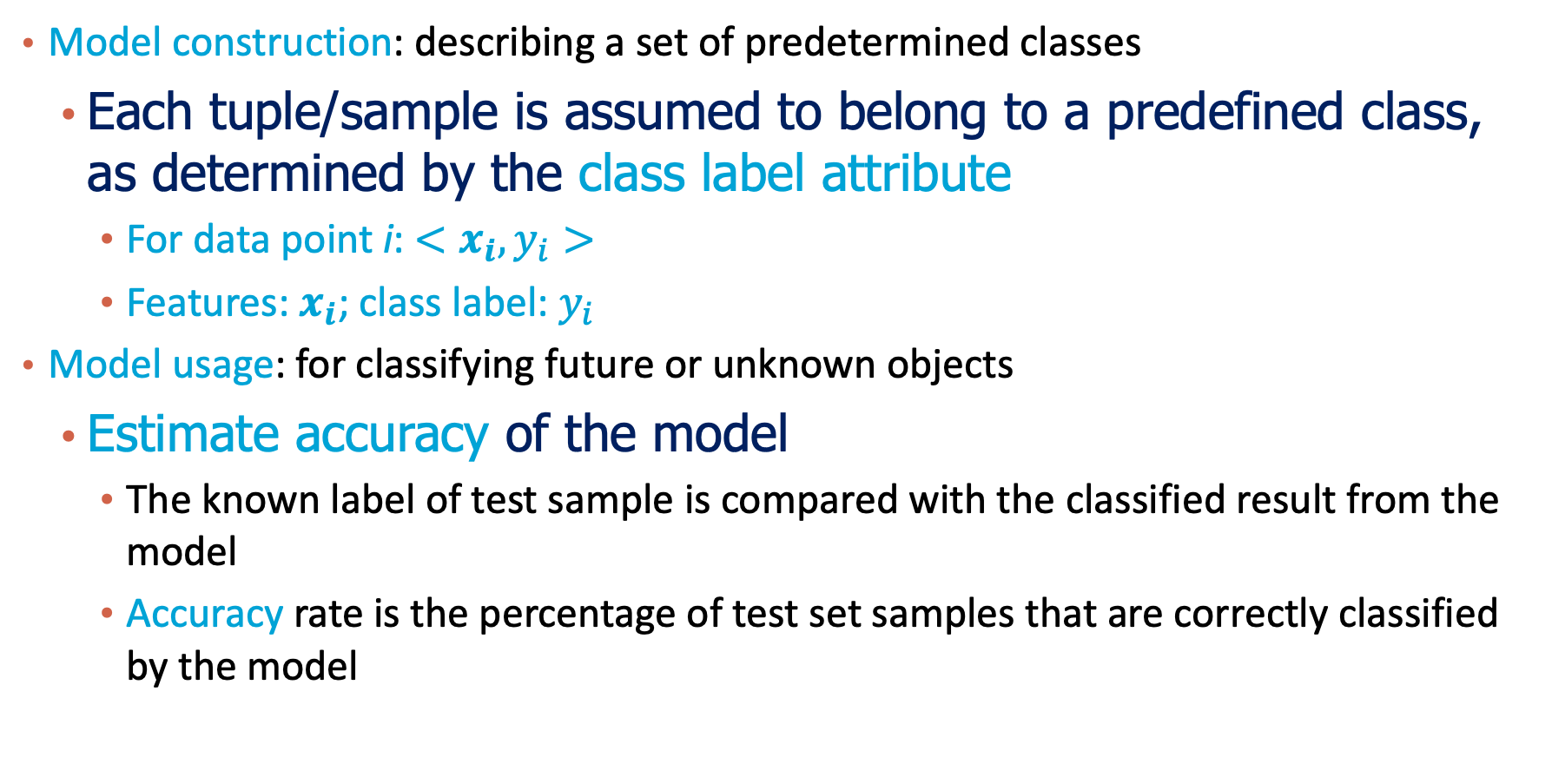
Classification Metric: Test Accuracy
Model construction: describing a set of predetermined classes
Each tuple/sample is assumed to belong to a predefined class, as determined by the class label attribute
For data point i: $<x_{i},y_{i}>$
Features: $x_{i}$; class label: $y_{i}$
Model usage: for classifying future or unknown objects
Estimate accuracy of the model
The known label of test sample is compared with the classified result from the model
Accuracy rate is the percentage of test set samples that are correctly classified by the model

Slide 21
Training: Model Construction
Classification
Algorithms
Training
Data
Classifier
(Model)
IF rank = ‘professor’
OR years > 6
THEN tenured = ‘yes’

Slide 22
Validation and Test
Classifier
ValidationData
Unseen Data
(Jeff, Professor, 4)
Tenured?

Slide 23
Model Evaluation and Selection
Evaluation metrics: How can we properly measure accuracy? Other metrics to consider?
Use validation/test set of class-labeled tuples instead of training set when assessing accuracy
Methods for estimating a classifier’s accuracy:
Holdout method
Cross-validation

Slide 24
Evaluating Classifier Accuracy: Holdout & Cross-Validation Methods
Holdout method
Given data is randomly partitioned into two independent sets
Training set (e.g., 2/3) for model construction
Test set (e.g., 1/3) for accuracy estimation
Cross-validation (k-fold, where k = 10 is most popular)
Randomly partition the data into k mutually exclusive subsets, each approximately equal size
At i-th iteration, use D_{i} as test set and others as training set
Leave-one-out: k folds where k = # of tuples, for small sized data

Slide 25
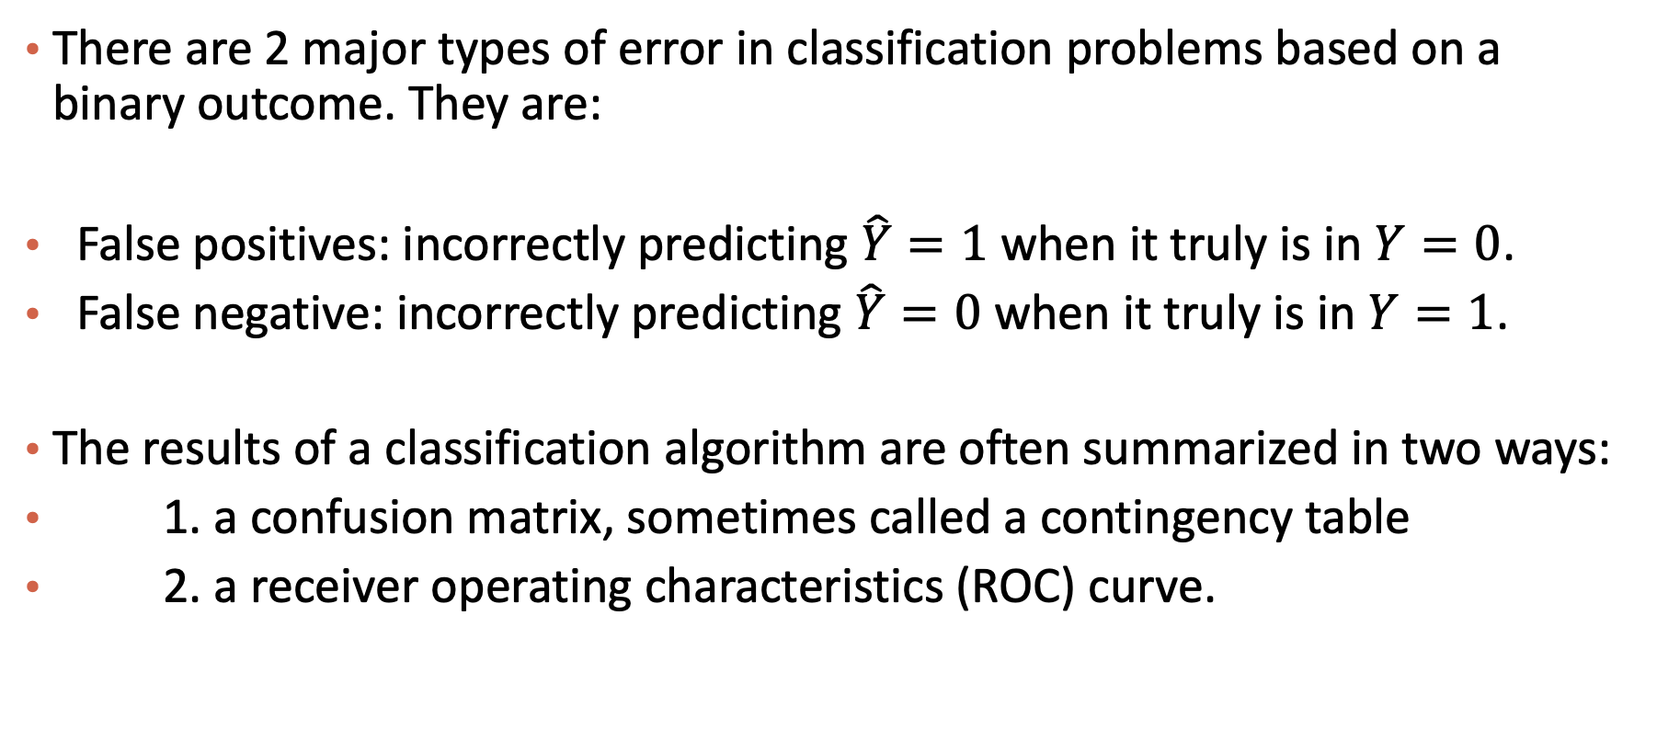
Beyond Accuracy: Error Analysis in Classification
There are 2 major types of error in classification problems based on a binary outcome. They are:
False positives: incorrectly predicting $\hat{Y}=1$ when it truly is in $Y=0$.
False negative: incorrectly predicting$\hat{Y}=0$ when it truly is in $Y=1$.
The results of a classification algorithm are often summarized in two ways:
1. a confusion matrix, sometimes called a contingency table
2. a receiver operating characteristics (ROC) curve.

Slide 26
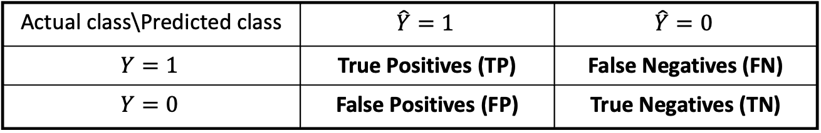
Classifier Evaluation Metrics: Confusion Matrix
Confusion Matrix:
Actual class\Predicted class | $$\hat{Y}=1$$ | $$\hat{Y}=0$$
$$Y=1$$ | True Positives (TP) | False Negatives (FN)
$$Y=0$$ | False Positives (FP) | True Negatives (TN)
Example of Confusion Matrix:
Actual class\Predicted class | buy_computer = yes | buy_computer = no | Total
buy_computer = yes | 6954 | 46 | 7000
buy_computer = no | 412 | 2588 | 3000
Total | 7366 | 2634 | 10000
May have extra rows/columns to provide totals
Acc = (TP + TN) / Total
26

Slide 27

Please download and install the Slido app on all computers you use
Suppose 99% of the people are labeled as negative for a disease, what is the accuracy for a classifier that classifies everyone into the negative class?
ⓘ Start presenting to display the poll results on this slide.

Slide 28
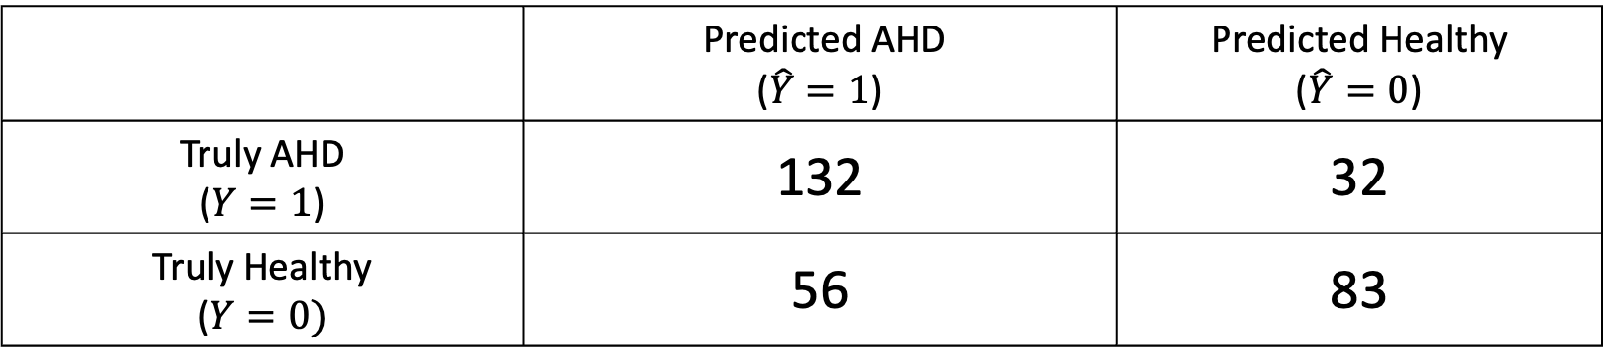
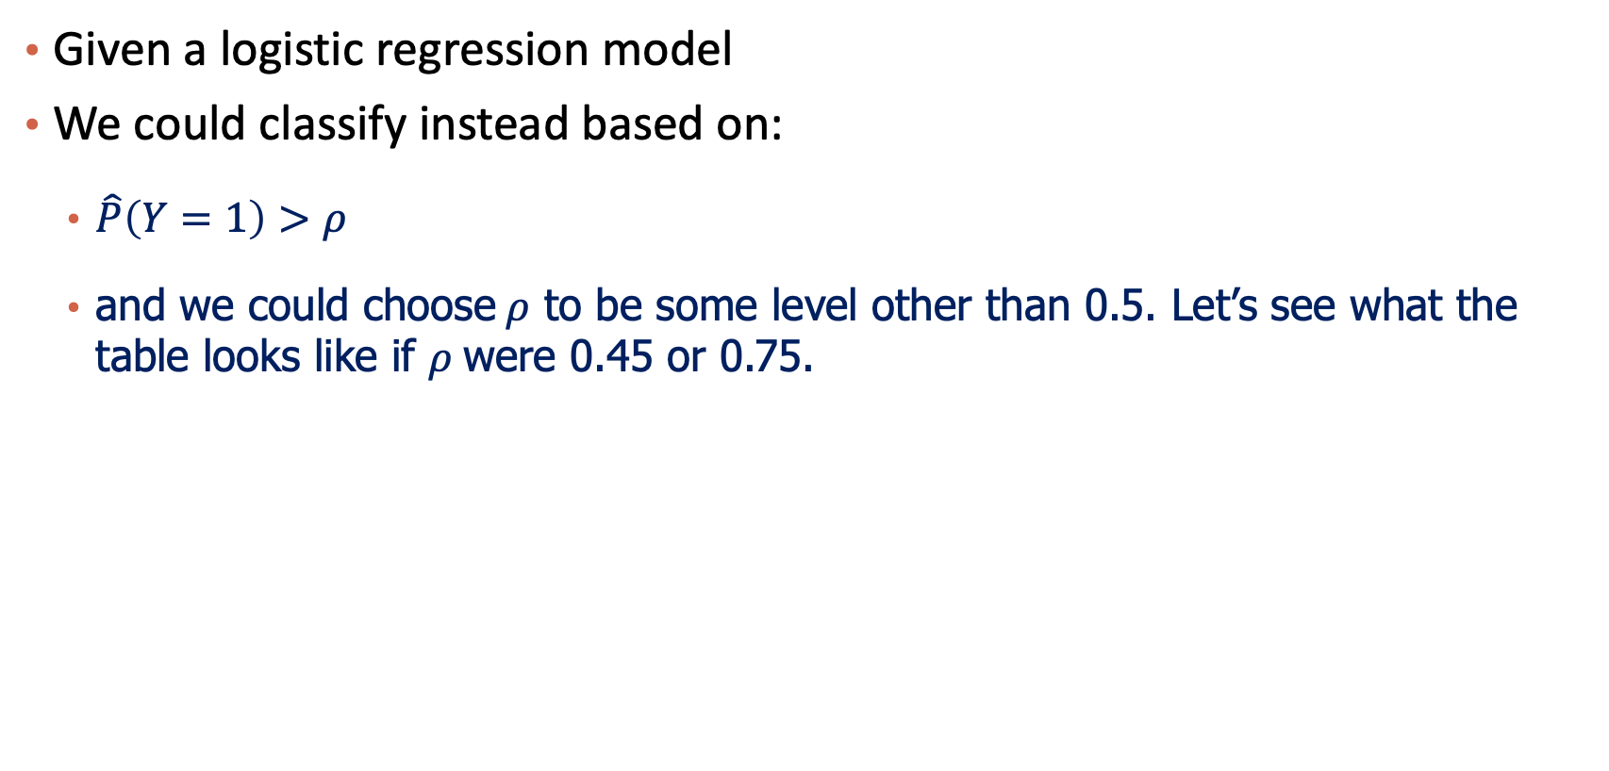
Choose threshold for classification?
Given a logistic regression model
We could classify instead based on:
$\hat{P}\left(Y=1\right)>ρ$
and we could choose$ρ$ to be some level other than 0.5. Let’s see what the table looks like if $ρ$were 0.45 or 0.75.
 | Predicted AHD ($\hat{Y}=1$) | Predicted Healthy ($\hat{Y}=0$)
Truly AHD ($Y=1$) | 132 | 32
Truly Healthy ($Y=0)$ | 56 | 83
$$ρ=0.5$$

Slide 29
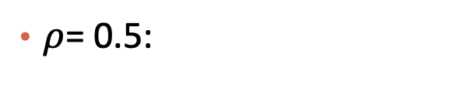
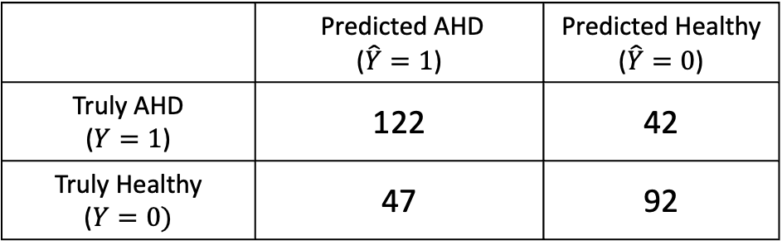


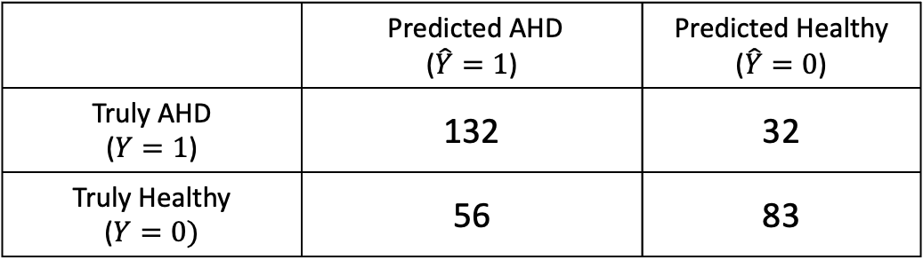
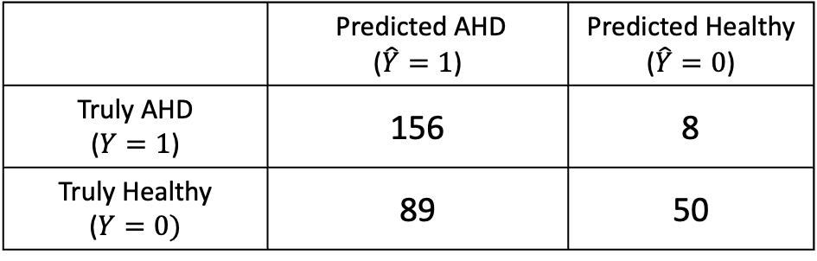
Other Confusion Matrix
What has improved? What has gotten worse?
Which should we choose? Why?
$ρ$= 0.5:
 | Predicted AHD ($\hat{Y}=1$) | Predicted Healthy ($\hat{Y}=0$)
Truly AHD ($Y=1$) | 132 | 32
Truly Healthy ($Y=0)$ | 56 | 83
$ρ$= 0.75:
$ρ$= 0.45:
 | Predicted AHD ($\hat{Y}=1$) | Predicted Healthy ($\hat{Y}=0$)
Truly AHD ($Y=1$) | 122 | 42
Truly Healthy ($Y=0)$ | 47 | 92
 | Predicted AHD ($\hat{Y}=1$) | Predicted Healthy ($\hat{Y}=0$)
Truly AHD ($Y=1$) | 156 | 8
Truly Healthy ($Y=0)$ | 89 | 50
Notes:
Higher false positive (42) for 0.45
Lower false positive (8) for 0.75 (higher sensitivity to Y=1 class)

Slide 30
Classifier Evaluation Metrics: Accuracy, Error Rate, Sensitivity and Specificity
A\P | 1 | 0
1 | TP | FN | P
0 | FP | TN | N
 | P’ | N’ | All
Class Imbalance Problem:
One class may be rare, e.g. fraud, or HIV-positive
Significant majority of the negative class and minority of the positive class
Sensitivity: True Positive recognition rate
Sensitivity = TP/P
Specificity: True Negative recognition rate
Specificity = TN/N
Classifier Accuracy, or recognition rate: percentage of test set tuples that are correctly classified
Accuracy = (TP + TN)/All
Error rate: 1 – accuracy, or
Error rate = (FP + FN)/All

Slide 31
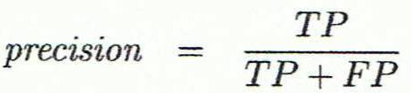
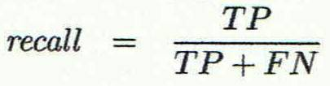
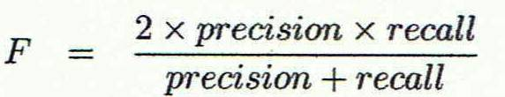
Classifier Evaluation Metrics: Precision and Recall, and F-measures
Precision: exactness – what % of tuples that the classifier labeled as positive are actually positive
Recall: completeness – what % of positive tuples did the classifier label as positive?
Perfect score is 1.0
Inverse relationship between precision & recall
F measure (F₁ or F-score): harmonic mean of precision and recall
Notes:
Quiz: what if \beta = 0? If \beta is bigger value, recall plays a more important role

Slide 32
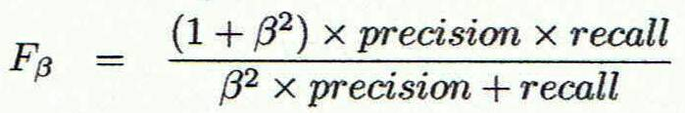
Classifier Evaluation Metrics: Precision and Recall, and F-measures
Precision: exactness – what % of tuples that the classifier labeled as positive are actually positive
Recall: completeness – what % of positive tuples did the classifier label as positive?
Perfect score is 1.0
Inverse relationship between precision & recall
F measure (F₁ or F-score): harmonic mean of precision and recall
F_{ß}: weighted measure of precision and recall
assigns ß times as much weight to recall as to precision
Notes:
Quiz: what if \beta = 0? If \beta is bigger value, recall plays a more important role

Slide 33
Classifier Evaluation Metrics: Example
Actual Class\Predicted class | cancer = yes | cancer = no | Total | Recognition(%)
cancer = yes | 90 | 210 | 300 | 30.00 (sensitivity)
cancer = no | 140 | 9560 | 9700 | 98.56 (specificity)
Total | 230 | 9770 | 10000 | 96.50 (accuracy)
Precision = 90/230 = 39.13% Recall = 90/300 = 30.00%
33

Slide 34
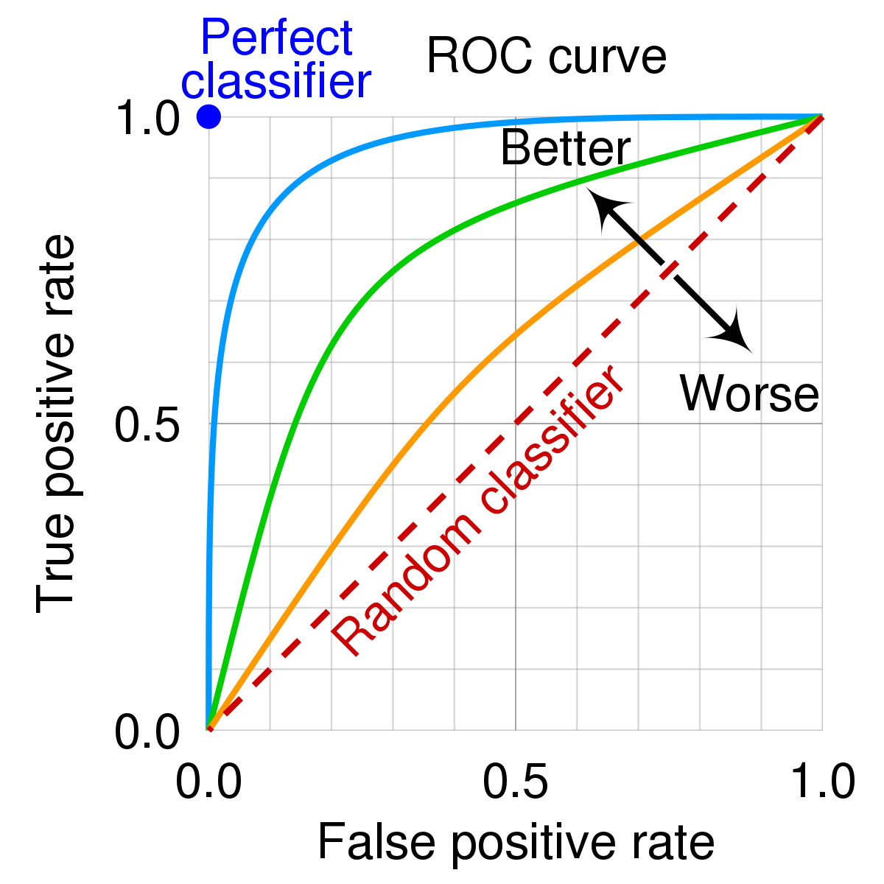
Classifier Evaluation Metrics: ROC Curves
ROC (Receiver Operating Characteristics) curves: for visual comparison of classification models
Shows the trade-off between the true positive rate and the false positive rate
The area under the ROC curve is a measure of the accuracy of the model
Rank the test tuples in decreasing order: the one that is most likely to belong to the positive class appears at the top of the list
Area under the curve: the closer to the diagonal line (i.e., the closer the area is to 0.5), the less accurate is the model
Vertical axis represents the true positive rate
Horizontal axis rep. the false positive rate
The plot also shows a diagonal line
A model with perfect accuracy will have an area of 1.0

Slide 35
Plotting an ROC Curve
True positive rate: $TPR=TP/P$ (sensitivity)
False positive rate: $FPR=FP/N$ (1-specificity)
Rank tuples according to how likely they will be a positive tuple
Idea: when we include more tuples in, we are more likely to make mistakes, that is the trade-off!
Nice property: no threshold (cut-off) need to be specified, only rank matters

Slide 36
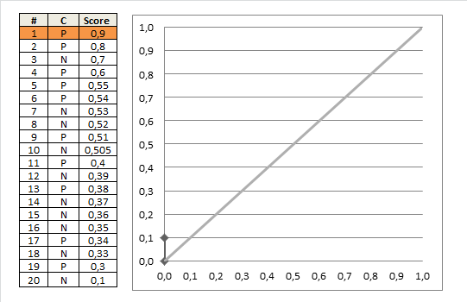
Example
TPR
FPR

Slide 37
Exercise
If according to the predicted probabilities, you put all the positive data points before negative data points: what will your ROC curve look like?
P
P
P
P
P
N
N
N

Slide 38
ROC Curve Example

Slide 39
Please download and install the Slido app on all computers you use
Audience Q&A Session
ⓘ Start presenting to display the audience questions on this slide.

Slide 40
Content
Regularization in Logistic Regression
Model Evaluation in Classification
Practical Issues

Slide 41
Multiclass Classification
Multiclass classification
Classification involving more than two classes (i.e., > 2 Classes)
Each data point can only belong to one class
Notes:
http://www.mit.edu/~9.520/spring09/Classes/multiclass.pdf

Slide 42
Solutions Using Binary Classifiers
Method 1. One-vs.-all (OVA): Learn a classifier one at a time
Given m classes, train m classifiers: one for each class
Classifier j: treat tuples in class j as positive & all others as negative
To classify a tuple X, choose the classifier with maximum value
Method 2. All-vs.-all (AVA): Learn a classifier for each pair of classes
Given m classes, construct m(m-1)/2 binary classifiers
A classifier is trained using tuples of the two classes
To classify a tuple X, each classifier votes. X is assigned to the class with maximal vote
Comparison
All-vs.-all tends to be superior to one-vs.-all

Slide 43
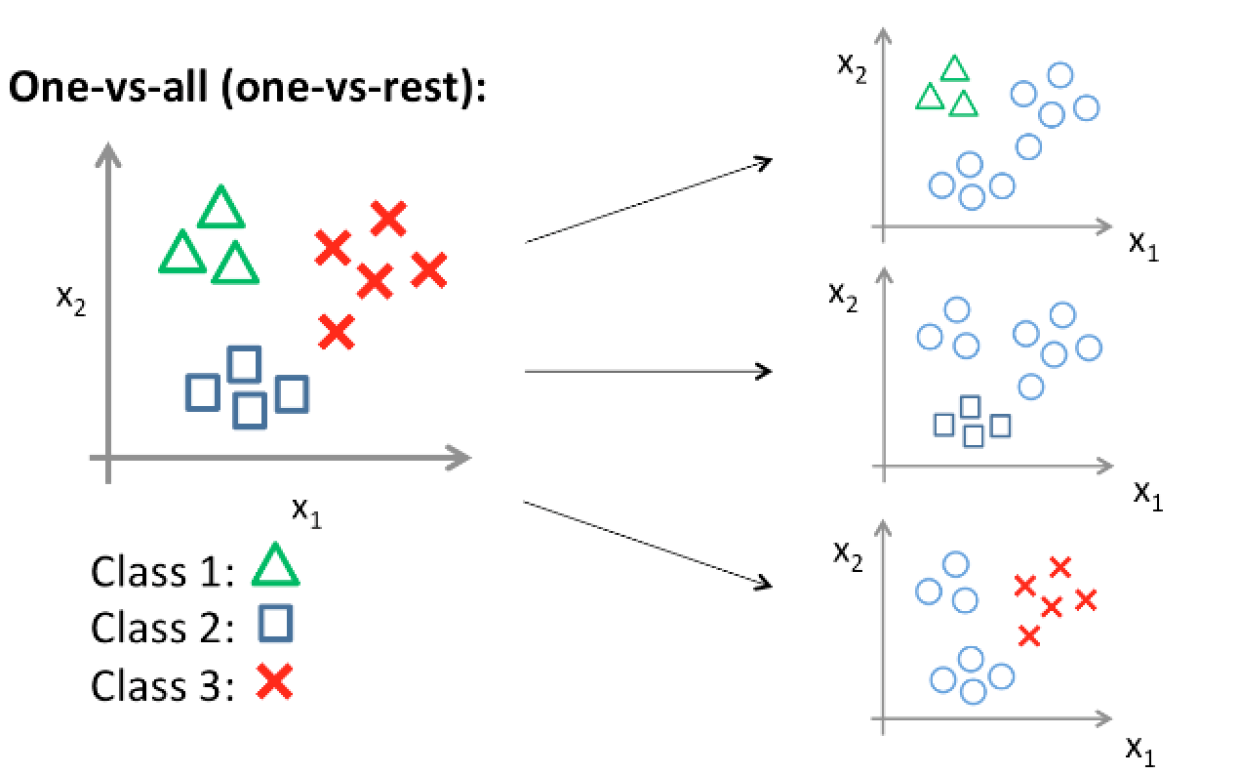
Illustration of One-vs-All
$$f_{1}(x)$$
$$f_{2}(x)$$
$$f_{3}(x)$$
Classify x according to: $f\left(x\right)=argmax_{i}f_{i}(x)$

Slide 44
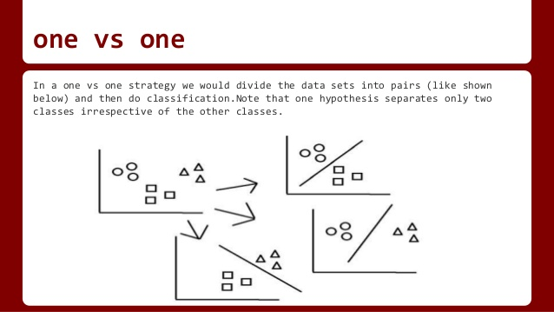
Illustration of All-vs-All
Classify x according to majority voting

Slide 45
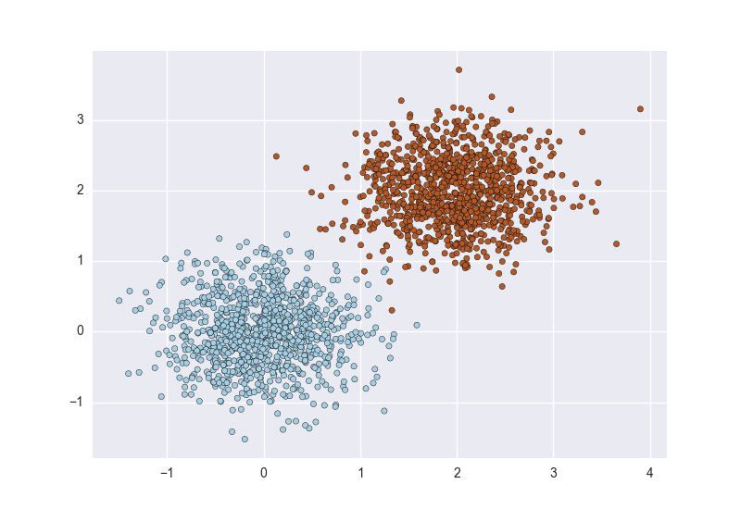
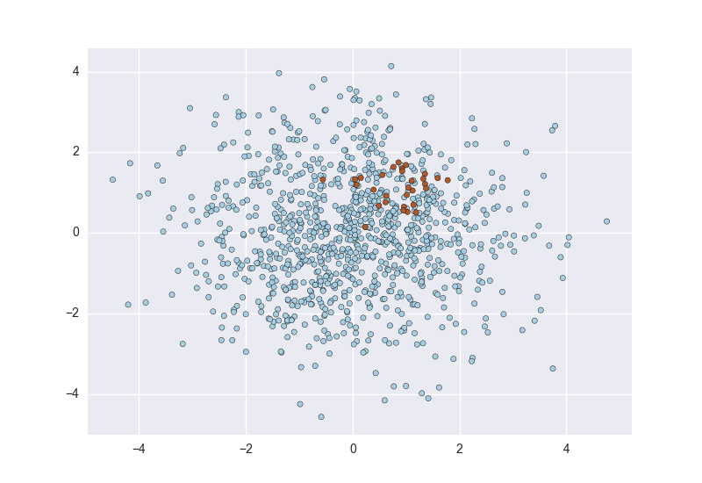
Classification of Class-Imbalanced Data Sets
Class-imbalance problem
Rare positive example but numerous negative ones, e.g., medical diagnosis, fraud, oil-spill, fault, etc.
Traditional methods
Assume a balanced distribution of classes and equal error costs: not suitable for class-imbalanced data
Balanced dataset
Imbalanced dataset
How about predicting every data point as blue class?
Notes:
https://svds.com/learning-imbalanced-classes/

Slide 46
Solutions
Pick the right evaluation metric
E.g., ROC is better than accuracy
Typical methods for imbalance data in 2-class classification (training data):
Oversampling: re-sampling of data from minority class
Under-sampling: randomly eliminate tuples from majority class
Synthesizing new data points for minority class
Still difficult for class imbalance problem on multiclass tasks
https://svds.com/learning-imbalanced-classes/

Slide 47
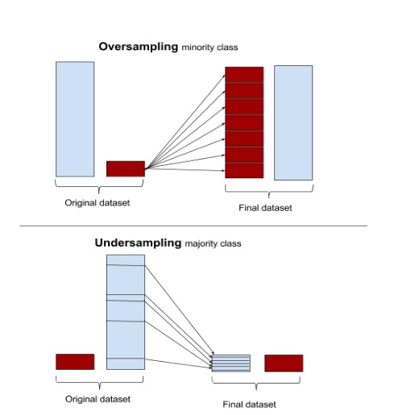
Illustration of Oversampling and Undersampling

Slide 48
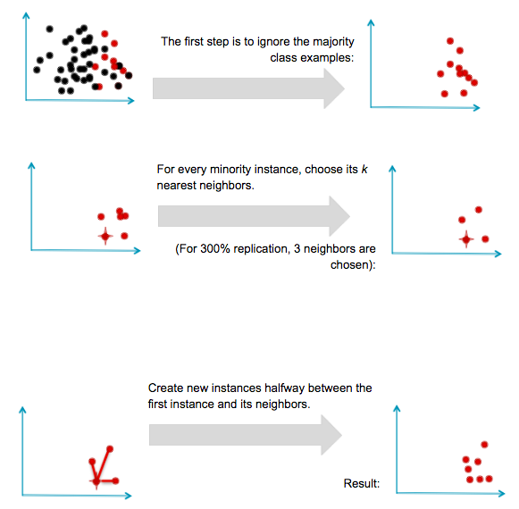
Illustration of Synthesizing New Data Points
SMOTE: Synthetic Minority Oversampling Technique (Chawla et. al)

Slide 49
Summary
Regularization in Logistic Regression
Model evaluation and selection
Evaluation metrics
Other issues
Multi-class classification
Imbalanced classes

Slide 50
Please download and install the Slido app on all computers you use
Audience Q&A Session
ⓘ Start presenting to display the audience questions on this slide.

